Slide 1

Black Friday Sales Prediction
Bhavesh Khanchandani
© All rights reserved by Fireblaze Technologies Pvt. Ltd.

Slide 2
Problem Statement
A retail company “ABC Private Limited” wants to understand the customer purchase behavior (specifically, purchase amount) against various products of different categories.
They have shared purchase summaries of various customers for selected high volume products from last month.
The data set also contains customer demographics (age, gender, marital status, citytype, stayincurrentcity), product details (productid and product category) and Total purchase amount from last month.
Now, they want to build a model to predict the purchase amount of customers against various products which will help them to create personalized offers for customers against different products.
© All rights reserved by Fireblaze Technologies Pvt. Ltd.

Slide 3
Proposed Solution
© All rights reserved by Fireblaze Technologies Pvt. Ltd.

Slide 4
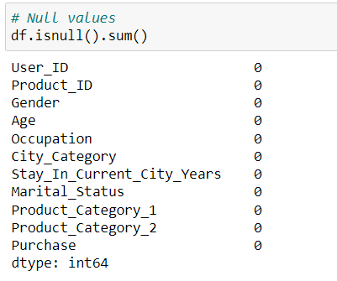
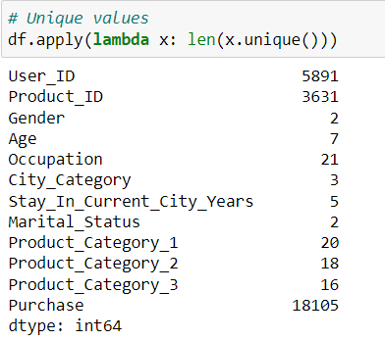
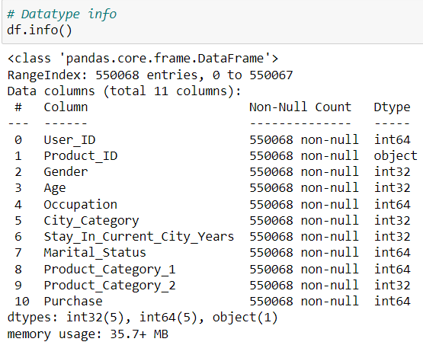
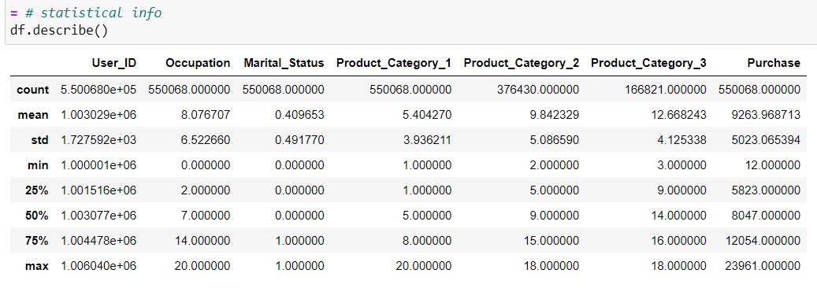
Descriptive Analysis
© All rights reserved by Fireblaze Technologies Pvt. Ltd.

Slide 5
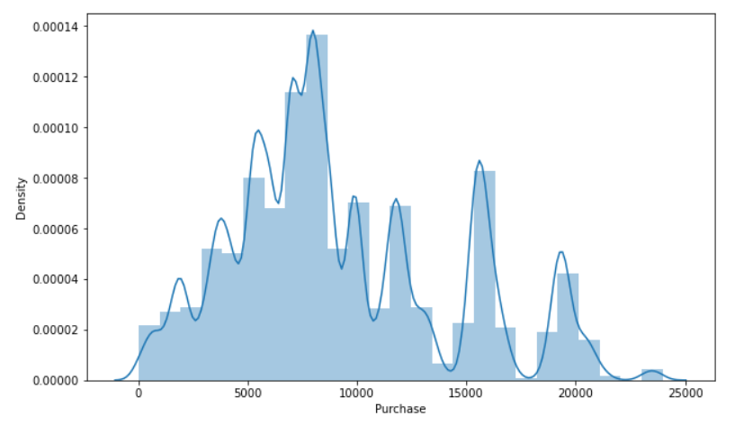
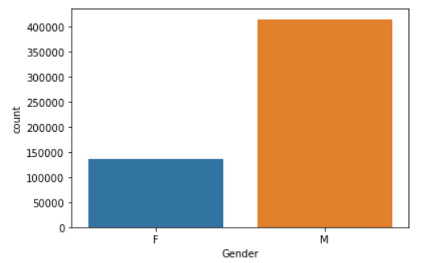
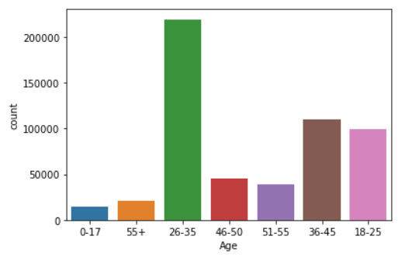
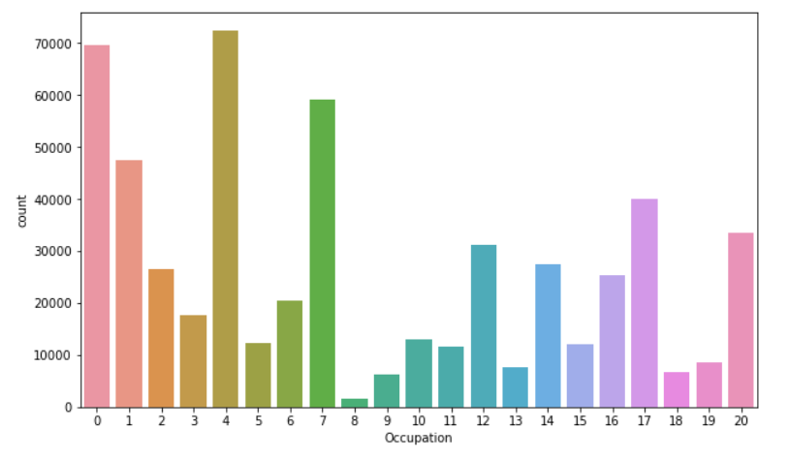
Exploratory Data Analysis
Observations
Graph 1 We can see the Highest purchase range is between 5000 to 10000
In graph 2 we can see that M ie Males have Placed more orders, Maybe they are more interested in black Friday sales than females.
In graph 3 we can see that the most orders were placed by the age group 26-35
In graph 4 we can see that occupations 0, 4, 7, have placed more orders
© All rights reserved by Fireblaze Technologies Pvt. Ltd.

Slide 6
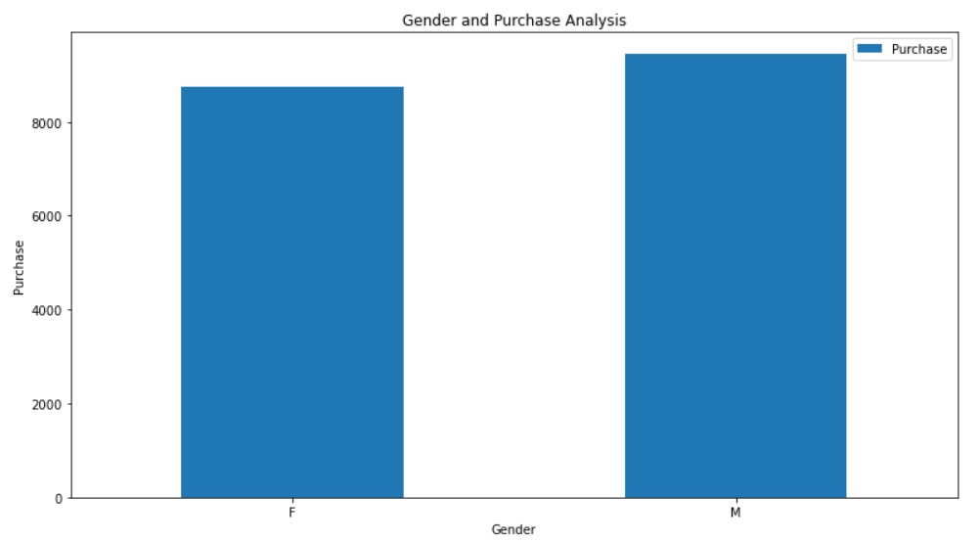
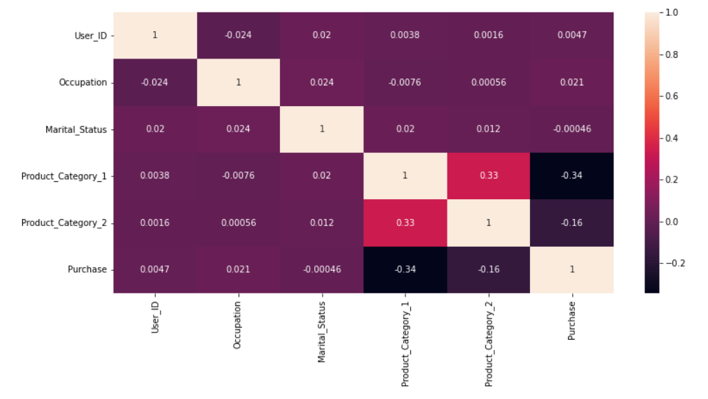
Exploratory Data Analysis
Observations
Graph 1 We can see the Highest purchase range is between 5000 to 10000
In graph 2 we can see that M ie Males have Placed more orders, Maybe they are more interested in black Friday sales than females.
In graph 3 we can see that the most orders were placed by the age group 26-35
In graph 4 we can see that occupations 0, 4, 7, have placed more orders
© All rights reserved by Fireblaze Technologies Pvt. Ltd.

Slide 7
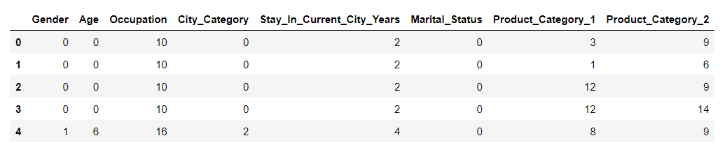
Machine Learning Modelling
© All rights reserved by Fireblaze Technologies Pvt. Ltd.

Slide 8
Optimisation
© All rights reserved by Fireblaze Technologies Pvt. Ltd.

Slide 9
Conclusion
© All rights reserved by Fireblaze Technologies Pvt. Ltd.

Slide 10
Future Scope
© All rights reserved by Fireblaze Technologies Pvt. Ltd.

